Slide 1

INSTITUTE :UIE
DEPARTMENT: ACADEMIC UNIT 1 & 4
Bachelor of Engineering
Subject Name and Code:
Engineering Physics 23SPH-141
Prepared by: Anu Kapoor, Assistant Prof. Physics
LASER
DISCOVER . LEARN . EMPOWER

Slide 2
COURSE OBJECTIVES
The course is designed to make the students industry ready to contribute in the growing demand of the industry at local, national and international level.
It will make the students competent to understand basic concepts and applications of advanced engineering physics and apply its principles in their respective fields at global platform.
It will enhance the skill level of the students and shall make them preferred choice for getting employment in industry and research labs.
It will give thorough knowledge of the discipline to enable students to disseminate knowledge in pursuing excellence in academic areas.

Slide 3
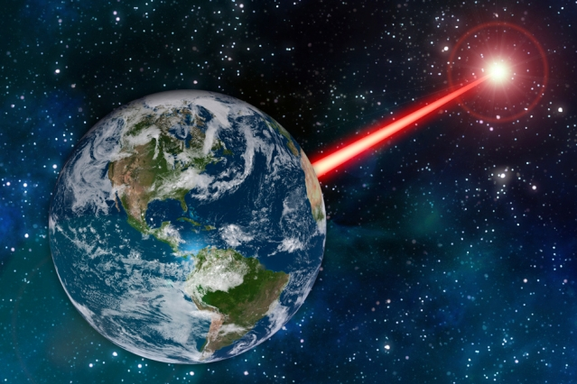
COURSE OUTCOMES
CO Number | Title On completion of this course, the students are expected to learn | Level
CO1 | Quote the basic fundamental concepts of lasers, optical fibres, crystallography, ultrasonic oscillations, semiconductor physics, quantum mechanics and nanotechnology. | Remember, Understand
CO2 | Demonstrate the working of various lasers, fibre components, semiconductor devices; explain the behaviour of crystalline solids, quantum and nano-scale systems. | Understand
CO3 | Solve problems by applying principles related to lasers, fibres, semiconductors, oscillations, quantum and nanoscience. | Applying Analyze
CO4 | Compare various lasers and fibres, semiconducting devices, crystalline materials, structures at quantum and nanoscale on the basis of their properties for industrial applications. | Analyze
CO5 | Develop various systems using lasers, fibres, semiconductors and nanomaterials for futuristic applications. | Design
Fig. 1 Introduction [1]

Slide 4

“ In the War of Worlds, written before the turn of 20th century, HG Wells told a fanciful story of how Martians invaded and almost conquered the earth. Their weapon was a mysterious sword of heat, from which flickered a ghost of a beam of light. It felled men in their tracks, made lead run like water and flashed anything combustible into masses of flame. Today Well’s word of heat comes close to reality in the laser…………”
Fig. 2 Introduction [2]

Slide 5

WHY TO STUDY LASER
Offering a high-speed way to process various materials, lasers are being used on a large scale in various industries.
Innovative technologies are driving the growth of industrial lasers. Manufacturers are introducing technologically advanced industrial lasers for various applications.
The global industrial laser market is highly dynamic, and growing at a fast pace.
The increasing innovations taking place in fiber lasers play an important role in the growth of the global industrial laser market
https://www.youtube.com/watch?v=_yLfLDHBUak [3]

Slide 6

CONTENT TO BE DISCUSSED….
Recap of Introduction to LASERS
Recap of Processes
Recap of Einstein’s Coefficients
Components of Laser
Three & Four Level lasers
Fig. 3 Introduction [4]

Slide 7
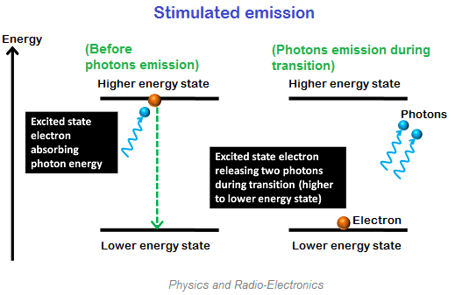
LASER EMISSION
L –Light
A – Amplification by
S – Stimulated
E – Emission of
R – Radiation
Stimulated Emission is the key to the laser action
Fig. 4 Stimulated emission [5]

Slide 8
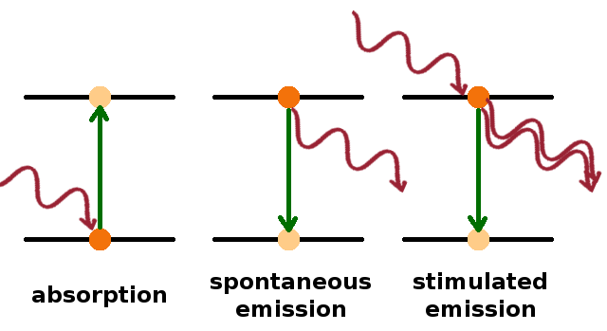


VARIOUS ATOMIC INTERACTIONS RELATED TO LASER
So the three processes can be summarized through this diagram………………
Total Probability of emission of transition from upper level 2 to the lower level 1 is given by
Or
Fig. 5 Three processes [8]

Slide 9
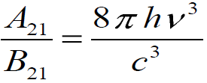



EINSTEIN’S COEFFICIENTS

Slide 10
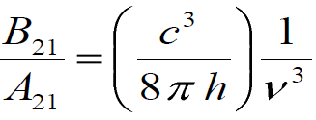
SIGNIFICANCE OF EINSTEIN’S COEFFICIENTS
That is B21/A21 is inversely proportional to frequency of the resonant radiation. Therefore, higher the frequency smaller is the value of B21. That is, it is comparatively difficult to obtain the stimulated emission of higher frequencies.

Slide 11

CONDITIONS FOR AMPLICATION
We Know from the probability of three processes , the three rate equations are
$R_{ab}=N_{1}B_{12}u\left(v\right)$ .......(1)
$R_{sp}=N_{2}A_{21}$……………(2)
$R_{st}=N_{2}B_{21}u(v)$…… .(3)
The ratio of stimulated emission and absorption yields
$$\frac{R_{st}}{R_{ab}}=\frac{N_{2}}{N_{1}}$$
And ratio of stimulated emission and spontaneous emission yields
$$\frac{R_{st}}{R_{sp}}=\frac{B_{21}u(v)}{A_{21}}$$
Which implies N2 should be higher than N1 for stimulated emission to dominate
Which implies u(v) should be high and A21 should be small for stimulated emission to dominate

Slide 12
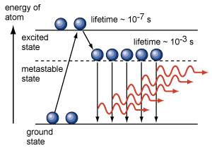
POPULATION INVERSION
When N₂ >N₁
This condition is know as population inversion.
N2 is the number of atoms in metastable state
N1 is the number of atoms in in ground state
LASER
Figure 6 Population Inversion [9]

Slide 13
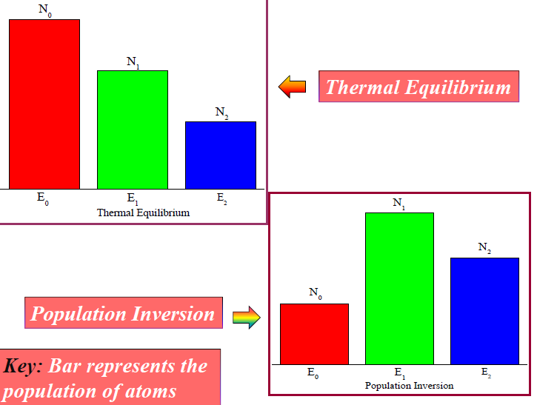
POPULATION INVERSION
Figure 7 Population Inversion [10]

Slide 14
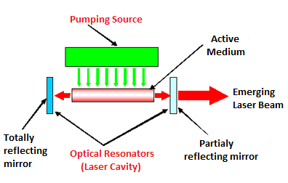
COMPONENTS OF LASER SYSTEM
Space for visual (size 24)
The Pump
Active Medium
The Resonator
Figure 8 Components of laser [10]

Slide 15
COMPONENTS OF LASER SYSTEM
1. The Pump:
It is an external source which supplies energy to obtain population inversion. The pump can be optical, electrical or thermal. In Ruby Laser, we use optical pumping and in He - Ne Laser, we use electric discharge pumping.
The energy supplied by the pump excites the atoms to higher energy levels and through spontaneous emission , atoms fall to metastable states
The lifetime of the metastable energy state, in which population inversion occurs must be very large as compared to the normal life time of the excited atom in any other energy state.

Slide 16
TYPES OF PUMPING
Optical Pumping:- Atoms are excited by external energy source.
Electrical Pumping:- Atoms are excited by electric field.
Chemical Reaction Pumping:- Energy is given by chemical process.
Direct Conversion:- Electrical energy directly converted into light.

Slide 17
COMPONENTS OF LASER SYSTEM
2. The Active Medium:
It is material in which the laser action is made to take place. It may be solid, liquid or gas. The very important characteristic requirement for the medium is that inversion should be possible in it. Many lasers are named after the material used.
For example: Ruby Laser and He-Ne laser
Only few atoms are responsible for laser action and are known as active centers while the rest of material is host.

Slide 18
COMPONENTS OF LASER SYSTEM
3. The Resonator:
It consists of a pair of plane or spherical mirrors having common principal axis. The reflection coefficient of one of the mirrors is very near to 1 and that of the other is kept less than 1. The resonator is basically a feed-back device, that directs the photons back and forth through the laser medium and in the process, the number of photons is multiplied due to stimulated emission.

Slide 19
PRINCIPLE OF LASER SYSTEM
An atomic system having one or two meta-stable states is chosen. Normally, the number of atoms in the lower energy state is greater than that in the meta stable state. This population is inverted by a technique known as pumping. The atoms are made to fall from meta-stable state to lower energy state and photons are emitted by stimulated emission. The photons are reflected back and forth in the active medium to excite the other atoms. Thus a large number of photons are emitted simultaneously which possess the same energy, phase and direction. This process is called ‘amplification of light’.

Slide 20
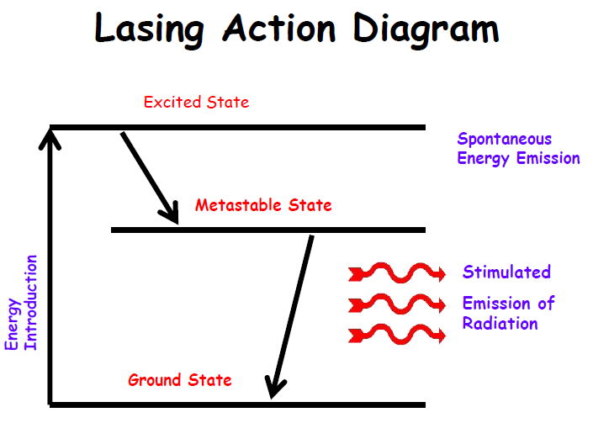
PRINCIPLE OF LASER SYSTEM
To produce laser beam, the following two conditions must be fulfilled:
The meta-stable state should all the time have larger number of atoms than the number of atoms in lower energy state.
The photons emitted due to stimulated emission should stimulate other atoms to multiply the photons in the active medium.
Figure 9 Three level system

Slide 21
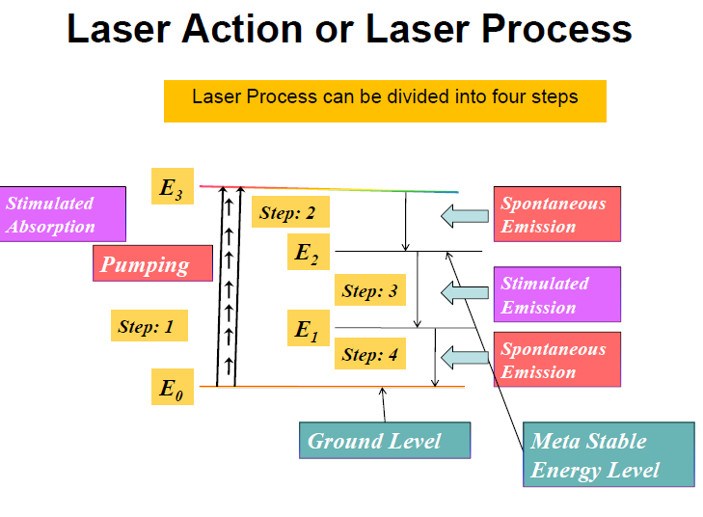

Slide 22
TYPES OF LASER SYSTEM
Different Lasers
Classification in number of ways:
According to the state of laser medium: Gas, Liquid and Solid Laser.
According to the type of pumping: Flash light, Chemical Action, and Electric Discharge Lasers
According to the nature of output: Pulsed (P) or Continuous Wave (CW) Lasers
Classification on the basis of Spectral region of the light: Ultra-Violet, Visible or Infra-Red Lasers.

Slide 23
3-LEVEL & 4-LEVEL LASER SYSTEM
E3
Fast decay
E2
Laser Transition
Pump Transition
E1
Three-level system : If you hit it hard, you get lasing
Four-level system :Lasing is easy!
E4
Fast decay
E3
Pump Transition
Laser Transition
E2
Fast decay
E1

Slide 24
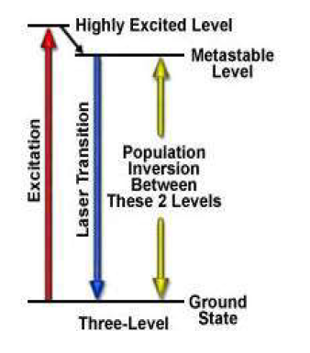
3-LEVEL LASER SYSTEM
Initially excited to a short-lived high-energy state .
Then quickly decay to the intermediate metastable level.
Population inversion is created between lower ground state and a higher-energy metastable state.
Figure 10 Three level system of laser [10]

Slide 25
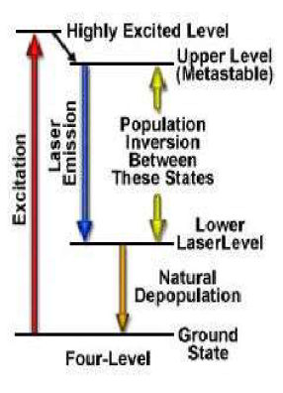
4-LEVEL LASER SYSTEM
Laser transition takes place between the third and second excited states.
Rapid depopulation of the lower laser level.
Figure 11 Four Level laser [10]

Slide 26
SUMMARY
Recap of Introduction to LASERS
Recap of Quantum Processes
Recap of Einstein’s Coefficients
Components of laser
Three & Four Level lasers

Slide 27
FAQS
What are the conditions for amplification of light?
Why are lasers uniquely hazardous?
What is the role of optical resonator?
Why pumping is done?
Compare three and four level laser
List advantages and disadvantages of Laser.

Slide 28
ASSESSMENT PATTERN
MST(02)
20 marks
Quiz
4 marks
Attendance
(>90%)
2 marks
Surprise test
4 marks
Assignment
10 marks

Slide 29
REFERENCES
[1] http://news.mit.edu/2018/laser-attract-alien-astronomers-study-1105
[2] https://www.gutenberg.org/files/36/36-h/36-h.htm
[3] https://www.youtube.com/watch?v=_yLfLDHBUak
[4] stockphoto.com/in/vector/abstract-red-laser-beam-transparent-isolated-on-black-background-vector-illustration-gm1048453908-280444377
[5] https://www.physics-and-radio-electronics.com/blog/absorption-of-radiation-spontaneous-emission-and-stimulated-emission/
[6] https://www.convergentlaser.com/laser-safety
[7] https://skullsinthestars.com/2008/09/03/optics-basics-coherence/
[8] https://users.aber.ac.uk/ruw/teach/327/spec.php
[9] http://www.hk-phy.org/articles/laser/3-states_e.gif
[10] https://www.mcgill.ca/ehs/laboratory/laser-safety/laser-safety-manual/appendices
[11] Laud B.B., Laser and Non -Linear Optics, Edition 1st, (1991), Wiley Eastern Ltd.
[12] Beiser A, Concepts of Modern Physics,Edition 6th, (2003),Tata Mcgraw Hill, Noida.
[13] Bhattacharya D. K., Tandon Poonam, Engineering Physics.,Edition 1st , (2015), Oxford.
[14] Ghatak A. (2012) Optics, McGraw Hill Education. ISBN: 978-1259004346.

Slide 30
THANK YOU
anukapoor.appsci@cumail.in

